Slide 1
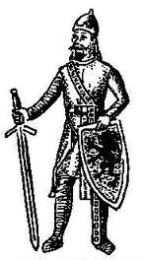
Torgils Knutsson
I mentioned first 1283 and is knighted 1289 by king Magnus Ladulås.
He conquered eastern Finland and founded the city of Viborg 1293 as a protection from the russians

Slide 2
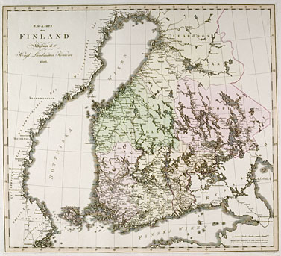

Slide 3
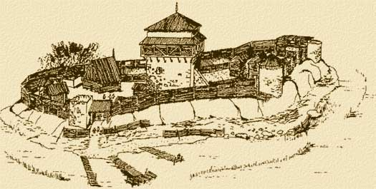
He started to build a castle in Viborg

Slide 4
He was prisoned on order av king Birger,
He sentenced to death and was beheaded in Stockholm 1306.

Slide 5
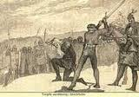

Slide 6
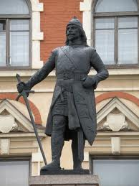
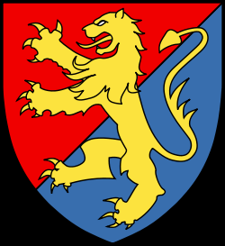
  -This statue of Torgils is in Viborg in todays Russia
His weapon

